Slide 1
Change Management
3/6/2022 Oksana Kustova

Slide 2
Change Management
Change management—also known as change enablement—is an IT practice designed to minimize disruptions to IT services while making changes to critical systems and services.
A change is adding, modifying, or removing anything that could have a direct or indirect effect on services.
Change management practices are designed to reduce incidents and meet regulatory standards.

Slide 3
Why is IT change management important?
Establishing a framework to manage the change process
Prioritizing necessary changes to properly allocate resources
Incorporating relevant information for smarter decision making
Involving necessary stakeholders from dev and IT for approvals
Incorporating testing of changes, to avoid incidents
Streamlining and improving the flow of changes to deliver value more quickly

Slide 4
Three type of changes
A standard change is a low-risk change that’s already well known, and it follows a strict procedure. Everyone loves these types of changes.
A normal change is, well, normal. You don’t know how risky these changes are; they’re either new or they’re those changes everyone is afraid to make because there’s always a problem with them. For these type of changes, you usually request approval from a change advisory board (CAB). The CAB analyzes it before going live, trying to deduce the impact on the system. Usually, IT Ops would like to avoid these types of changes.
Emergency changes are those that need immediate attention. You can’t wait for them to go through the formal approval process. Everyone would like to avoid these, but sometimes they’re inevitable.

Slide 5
The change management process
Change request
Change request review
Change plan
Change approval
Change implementation
Change closure

Slide 6
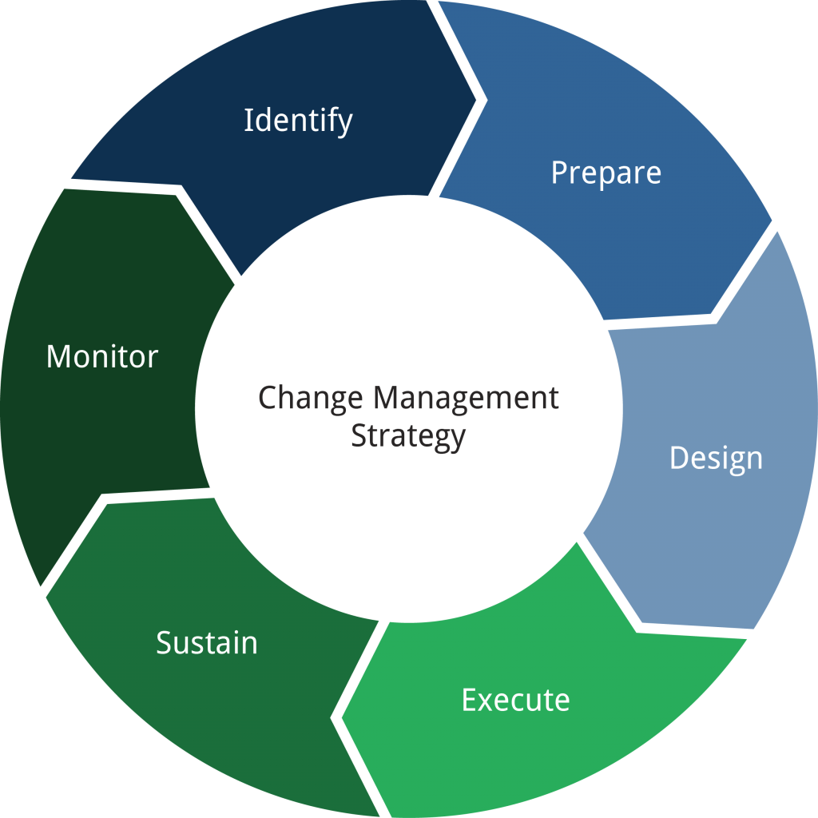
Change Management Strategy

Slide 7
Change management best practices
Understand your organization’s risk tolerance and regulatory obligations
Simplify and automate change management processes wherever possible
Give CABs a more strategic focus
Embrace practices that make standard change the new normal change
Look to various frameworks like ITIL and DevOps to find guidelines that work best for your organization

Slide 8
Change management best practices
Prioritize collaboration
Use chaos engineering to reduce your risk
Streamline change request intake for IT and developer teams
Unlock learning with change metrics and KPIs
Embrace a DevOps-driven approach to release management

Slide 9
Change management
DevOps is about a continuous and iterative approach, where speed and efficiency are at its core. Change management is often perceived as the total opposite of that.
DevOps is not trying to remove CM. It’s trying to make it more powerful.

Slide 10
References
Atlassian. (n.d.). The evolution of it change management. Atlassian. Retrieved March 6, 2022, from https://www.atlassian.com/itsm/change-management
How does DevOps Handle Change Management? Cprime. (2020, December 8). Retrieved March 6, 2022, from https://www.cprime.com/resources/blog/how-does-devops-handle-change-management/
How to implement Change Management in your supply chain. Clear Spider. (2019, December 17). Retrieved March 6, 2022, from https://clearspider.net/blog/implement-change-management/

